Slide 1



CONNECTICUT
SWIMMING
Awards Banquet – 2023
November 5th - Plantsville, CT

Slide 2
Welcome Remarks
CT Swimming
Rick Lewis
Board of Directors, General Chair

Slide 3
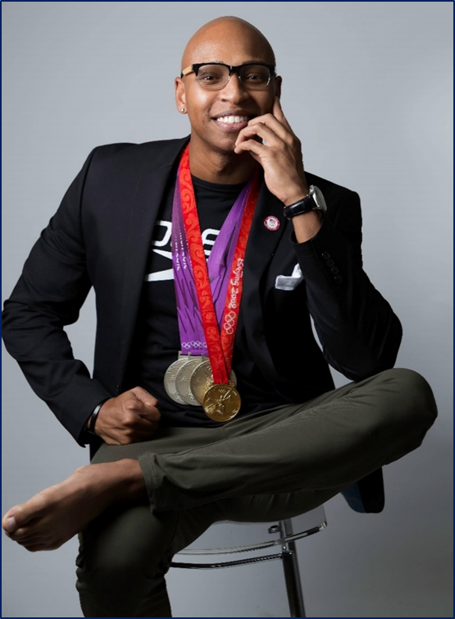
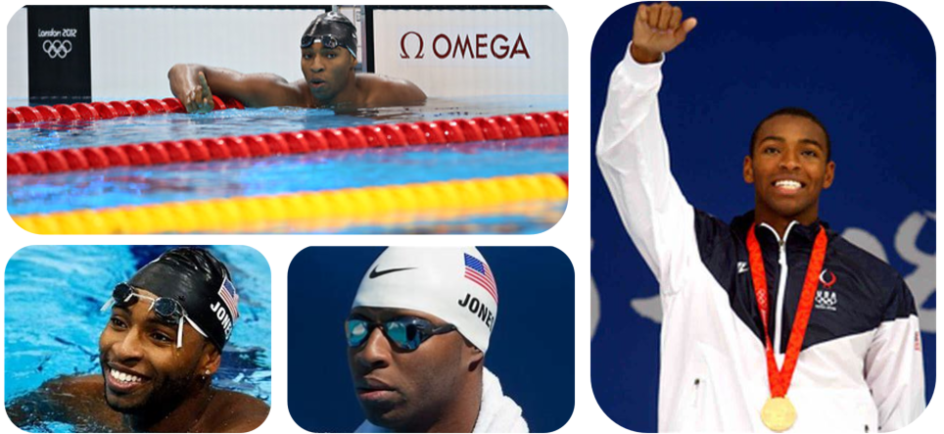
Guest Speaker / Emcee
Cullen Jones

Slide 4
Connecticut Swimming
Swimmers of the Year
Ellen Johnston, Immediate Past General Chair, introducing
2022-2023 Swimmer of the Year - Adaptive
Matthew Torres
Westport Water Rat Swim Team (WRAT)

Slide 5
Connecticut Swimming
Swimmers of the Year
Aaron Montgomery, Chelsea Piers Aquatic Club Coach introducing
2022-2023 Swimmer of the Year - Female
Annam Olasewere
Chelsea Piers Aquatic Club (CPAC)

Slide 6
Connecticut Swimming
Swimmers of the Year
Brian Fazzino, New Canaan Y Club Coach introducing
2022-2023 Swimmer of the Year - Male
Kalen Anbar
New Canaan YMCA Caimans (NCY)

Slide 7
USA Swimming
ConocoPhillips Outstanding Service Award
Rick Lewis, General Chair, introducing
2022-2023 ConocoPhillips Outstanding Service Award
Yolanda Jahan

Slide 8
Judy Snow
Service Award
Chris Snow introducing
2022-2023 Judy Snow Service Award
TBA

Slide 9

USA Swimming
Senior and Junior National Participants (slide 1 of 4)
USA Swimming National Team Members
Kieran Smith
USA Swimming LC National Championship Competitors
Kalen Anbar
Lillian Derivaux
Annam Olasewere
Kieran Smith
USA Swimming Para World Championship Team Member
Matthew Torres

Slide 10
USA Swimming
Senior and Junior National Participants (slide 2 of 4)
USA Paralympic National Championship SC Participants
Matthew Torres
USA Swimming Open National Championship SC Participants
Kalen Anbar
Riley Anderson
Alexey Belfar
Chris Ford
Cassidy Stotler
Annam Olaswere
Miller Ward

Slide 11
USA Swimming
Senior and Junior National Participants (slide 3 of 4)
USA Swimming Junior National Team Members
Annam Olasewere
USA Swimming Junior Worlds Team Members
Annam Olasewere
USA Swimming Junior National Championship LC Participants
Kalen Anbar
Sena Bozkhurt
Lilly Derivaux
Liam Flaherty
Olivia Hebert
Rian Hermann
Ingrid Janney
Chas Jones
Elliot Lee
Deacon Mascarinas
Kailey Simmons
Ben Wu

Slide 12
USA Swimming
Senior and Junior National Participants (slide 4 of 4)
Lila Strober
USA Swimming Open Water Championship Participants
Penny Lazar
USA Swimming Junior National Championship SC Participants
Riley Anderson
Sena Bozkurt
Aiden Bucaria
Jack Clancy
Brendan Connors
Liam Flaherty
Rian Hermann
Elliot Lee
Amelia Peterson
David Ponce
Ben Wu

Slide 13
Connecticut Swimming
Records (slide 1 of 10)
10/Under - SC and LC RECORDS

Slide 14
Connecticut Swimming
Records (slide 3 of 10)
13/14 - SC and LC RECORDS (continued next slide)

Slide 15
Connecticut Swimming
Records (slide 4 of 10)
13/14 - SC and LC RECORDS

Slide 16
Connecticut Swimming
Records (slide 5 of 10)
15/16 - SC and LC RECORDS

Slide 17
Connecticut Swimming
Records (slide 6 of 10)
15/16 - SC and LC RECORDS

Slide 18
Connecticut Swimming
Records (slide 7 of 10)
15/16 - SC and LC RECORDS

Slide 19
Connecticut Swimming
Records (slide 8 of 10)
17/18 - SC and LC RECORDS

Slide 20
Connecticut Swimming
Records (slide 9 of 10)
Senior - SC and LC RECORDS

Slide 21
Connecticut Swimming
Records (slide 10 of 10)
Senior - SC and LC RECORDS

Slide 22
USA Swimming
National Top 10 (slide 1 of 6)
USA Swimming – National Top 10 Times

Slide 23
USA Swimming
National Top 10 (slide 2 of 6)
USA Swimming – National Top 10 Times

Slide 24
USA Swimming
National Top 10 (slide 3 of 6)
USA Swimming – National Top 10 Times

Slide 25
USA Swimming
National Top 10 (slide 4 of 6)
USA Swimming – National Top 10 Times

Slide 26
USA Swimming
National Top 10 (slide 5 of 6)
USA Swimming – National Top 10 Times

Slide 27
USA Swimming
National Top 10 (slide 6 of 6)
USA Swimming – National Top 10 Times

Slide 28
Senior Coach of the Year
Rob Riccobon (WHAT), Senior Coach Representative and
Sarah Basile (RYWC) Junior Coach Representative introducing
2022-2023 Senior Coach of the Year
Chuck Clark
Rapids Swim Team
(RST)

Slide 29
Bill Krumm
Age Group Coach of the Year
Rob Riccobon (WHAT), Senior Coach Representative and
Sarah Basile (RYWC) Junior Coach Representative introducing
2022-2023 Bill Krumm Age Group Coach of the Year
David Fine
Greenwich YWCA Dolphins
(GYWD)

Slide 30
Staff of the Year
Rob Riccobon (WHAT), Senior Coach Representative and
Sarah Basile (RYWC) Junior Coach Representative introducing
2022-2023 Staff of the Year
RYWC
Regional YMCA of Western CT Makos

Slide 31

Senior Championship High Point Awards (slide 1 of 2)
Individual Results
Short Course Senior Championship Individual High Point
Overall
  Female Riley Kudlac
  Male Eliot Lee
Long Course Senior Championship Individual High Point
Overall
  Female Olivia Hebert
  Male Elliot Lee
Distance
  Female Katherine Beauchene
  Male Riley Twiss
Distance
  Female Meghan Tiernan
  Male Riley Twiss

Slide 32
Senior Championship High Point Awards (slide 2 of 2)
Team Results
Short Course Senior Championship Team High Point
Girls Cheshire Y Sea Dog Swim Club
Boys Bulldog Swimming
Overall Cheshire Y Sea Dog Swim Club
Long Course Senior Championship Team High Point
Girls Bulldog Swimming
Boys Bulldog Swimming
Overall Bulldog Swimming

Slide 33
Open Water Championship
Team Results
Open Water Championship Team Results
Girls West Hartford Aquatic Team
Boys West Hartford Aquatic Team
Overall West Hartford Aquatic Team

Slide 34
Age Group Championship High Point Awards (slide 1 of 3)
Individual Awards
Age Group Championship Individual High Point - Short Course
Overall Distance
10/U Girls Aubrey Bedard Vanessa Delev
10/U Boys Brody Michaels Brody Michaels
11/12 Girls Ana David (tie) Audrey Perevertaylo
            Kate Boutry (tie)
11/12 Boys Greg Pogosian Greg Pogosian
13/14 Girls Savannah Bowers Megan Grisanti
13/14 Boys Wyatt Vitiello Jonathan Packard

Slide 35
Age Group Championship High Point Awards (slide 2 of 3)
Individual Awards
Age Group Championship Individual High Point - Long Course
Overall Distance
10/U Girls Grace Wang Grace Wang
10/U Boys Charles Lowham Charles Lowham
11/12 Girls Audrey Perevertaylo (tie) Olivia Maltz Vivian Volenec (tie)
11/12 Boys Griffin Riebling (tie) Christopher McCauley
Beckett Krajewski (tie)
13/14 Girls Savannah Bowers Melissa Geiger
13/14 Boys Jonathan Packard Jonathan Packard

Slide 36
Age Group Championship High Point Awards (slide 3 of 3)
Team Awards
Age Group Championship Team Awards
Short Course Long Course
10/U Girls Stamford Sailfish Aquatic Club Stamford Sailfish Aquatic Club
10/U Boys Stamford Sailfish Aquatic Club Stamford Sailfish Aquatic Club
11/12 Girls Greenwich YWCA Dolphins Swim Team Stamford Sailfish Aquatic Club
11/12 Boys Stamford Sailfish Aquatic Club Stamford Sailfish Aquatic Club
13/14 Girls Westport/Weston Family Y Water Rats Westport/Weston Family Y Water Rats
13/14 Boys Wilton Y Wahoos Swim Club Wilton Y Wahoos Swim Club

Slide 37
USA Swimming
Scholastic All-America Team
Scholastic All-America Team
Schol
Riley Anderson
Lily Archibald
Julia Barto
Damian Czartoryjski
Jack Haley
Olivia Herbert
Abby King
Elliot Lee
Alexandra Moore
Kate Murray
Annam Olasewere
John Rusnock
Kailey Simons
Owen Tharrington

Slide 38
Connecticut Swimming
Scholar Athletes (slide 1 of 2)
Scholar Athletes
Addison Asuncion
Zachary Beckham
Michael Belpedio
Nolan Bernier
Julia Bevilacqua
Lucy Boisoneau
Katherine Brennan
Emily Butler
Gwendolyn Bye
Carly Cahill
Sophia Caldwell
John Comite
Sydney Dawes
Emily Denise
Lexi Dominguez
William Dwyer
Niall Easton
Andrew Filotto
Anna Gallagher
Ananya Garg
Rachel Gentil
Kaitlyn Gilbert
Alex Hite
Evan Huang
Lelan Jacheo
Marko Katra
Panya Khattar
Sarah Kim
Victoria Korczak
Gavin Lam
Taylor Leapley
Caleb Leon
Natalie Liguoei
Nathan Lowney
Derek Lui
Tommy Masotti

Slide 39
Connecticut Swimming
Scholar Athletes (slide 2 of 2)
Scholar Athletes
Lillian Miller
Emily Murphy
Beth Nedobity
Josie Nesta
Ryan Nguyen
Alina Niemczyk
Sydney O'Connell
Azra Ozgen
Arjun Padwal
Audrey Plourde
Ariana Potter
Chloe Retuya
Ruthie Riccobon
Emma Robredo
Paeton Romero
Jack Rosano
Sarah Rotariu
Reaghan Samson
Amelia Scheu
Sabrina Schuster
Christine Scully
Aiden Sesta
Alicia Shatalov
Molly Simmons
Colin Spoerndle
Chase Starzman
Emme Starzman
Jillian Sullivan
Isabel Torello
Madison Winslow
Leonardo Wong
Derek Yin
Bryan Zheng

Slide 40
Connecticut Swimming
Top 16 Scholar Athletes (slide 1 of 3)
Top 16 Scholar Athletes
Lily Archibald
Daniel Babashak
Hailey Baker
Katherine Beauchene
Andrew Berkowitz
Elizabeth Bodie
Kellen Booth
Sena Bozkurt
Samantha Chemacki
Isabelle Christensen
Lauren Clark
Shane Colligan
James Custer
Damian Czartoryjski
Avery D'Amour
Laura DeGennaro
Conor Duggan
John Dwyer
Annie Edwards
Maxwell Enes
Kristopher Flores
Amanda Ford
Natalia Gajecki
Michael Gauthier
Brielle Gold
Madisyn Goldstein
Ella Gussen
Benjamin Haddad
Samantha Haley
Phoebe Hamblett
Jane Harhay
Mackenzie Headley
Rian Herrmann
Molly Hoban
Eric Huang
Michael Ivanov

Slide 41
Connecticut Swimming
Top 16 Scholar Athletes (slide 2 of 3)
Top 16 Scholar Athletes
Samantha Jackson
Meghan Jo
Jasmine Johnson
Chas Jones
Brendan Kirberger
Aanya Kongettira
Mykhailo Kvashchuk
Jerick Luke Lagamao
Erik Lamphere
Penny Lazar
Addison Lezinsky
Marea Li
ShaunLi
Jacob Lin
Jenney Liu
Cody Lonsberry
Lauren Lord
Madison Marini
Campbell McFall
Jake Mercer
Kate Murray
Hannah Natlo
Hailey Newton
Molly Newton
Jocie Niemczyk
Boglarka Olah
Katrine O'Leary
Sara Omar
Nate Oppenheim
Cesar Padilla
Annika Paluska
Sydney Parker
Amelia Peterson
Abbey Pickel
Dani Schwartz
Lucy Schwarz

Slide 42
Connecticut Swimming
Top 16 Scholar Athletes (slide 3 of 3)
Top 16 Scholar Athletes
Chase Shapiro
Ved Shriyans Bathula
Ariya Snelwar
Julia Stidolph
Lila Strober
Lillian Teel
Julia Tejeda
Kristin Timpano
Anthomy Tomasko
Colten Trepp
Owen Vale
Andrew Villani
Jack Watson
Alex Weisenbacher
Michelle Weissler
Miriam Youel
Peter Zalewski
Marabella Zullo

Slide 43
Closing Remarks
CT Swimming
Rick Lewis
Board of Directors, General Chair

Slide 44
CONNECTICUT
SWIMMING
THANKS YOU!
See You On The Pool Deck!

